Slide 1
Course Title: Economics Code: Eco. 155 BIT 2nd Semester
Presented by Hemanta Rai
Assistant Professor Economics
Patan Multiple Campus
Tribhuvan University

Slide 2
Unit 4: production
Meaning of production and Production function (Cobb-Douglas production function) production with one variable inputs: law of diminishing marginal productivity/returns; production with two variable inputs: concept of Isoquant; properties of isoquant; right angled (L shaped) and linear (straight line) Isoquants; concept of Iso-cost curve (meaning, equation and slope); producer’s equilibrium condition for optimum employment of one, two and multi variable inputs/factors of production; production in long run: concept of returns to scale with possible causes of each.

Slide 3
Production:
Production is an economic activity to create the utility in goods and services
Addition of utility on goods and services
Those things which has the ability of capacity to satisfies the human wants are known as goods and services.
With change in the quantity, quality, size, shape, place, time we can add utilities on goods and services.
It is a process where we convert factor inputs/factors of production into outputs.
Factor inputs/factors of production/factors refers to the land, labor, capital, entrepreneurship/organization technology, raw material, fuel and others (land, labor, capital and organization)

Slide 4
Production function:
The functional, technical, mathematical relationship between volume of production (Output) and factors determinants of production.
A production function is a description of the quantitative relationship between the inputs absorbed and the outputs emerging from a particular production process.
Q= f(N,L,K,T,O and others
100kg= 10L+30K
Q = f (N) Q =output N= inputs

Slide 5
Short-run (one variable input) production function
The short-run production function establishes a functional relationship between the units of variable inputs with constant units or capacity of fixed inputs and the output.
Q = f (N_{vf ,}K)
Q = output N_{vf,} = units of variable inputs
f =function K = constant units of fixed inputs.
Short-run refers to that time period in which producer can not change all the factors of production but some factors of production can be changed.

Slide 6
Long-run (Multivariable) Production function
Long run production function establishes a functional relationship between all inputs and output.
Algebraically,
Multi-variable production function Q=f(W,L,K,M,T)
Or Two-variable production function Q=f(L,K)
Q=output, f=function, W=land, L=Labor, M=management, T= Technology

Slide 7
Cobb-Douglas Production function
Developed by C.W. Cobb American mathematician and P.H. Douglas economist in 1928AD.
It shows the multiplicative relationship between inputs and output.
It is a long run production function.
This is known as the empirical production function.
They modeled the growth of American economy during the period 1899-1922.
Mathematically,
Q=AK^{β}L^{α} Q= 20K^{.5}L^{.5}
Where Q=output, L=Labor, K=capital
A= efficiency parameter positive constant
α and β are the positive constant parameters (elasticity of output with respect to inputs)

Slide 8
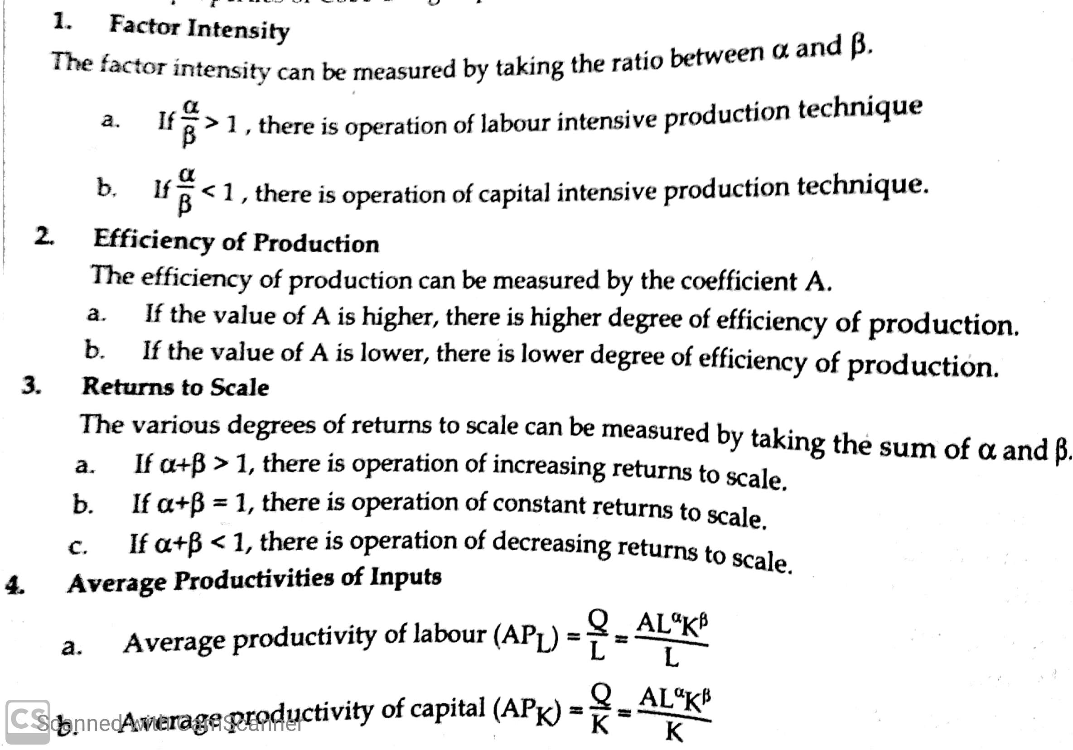
Properties of Cobb-Douglash

Slide 9
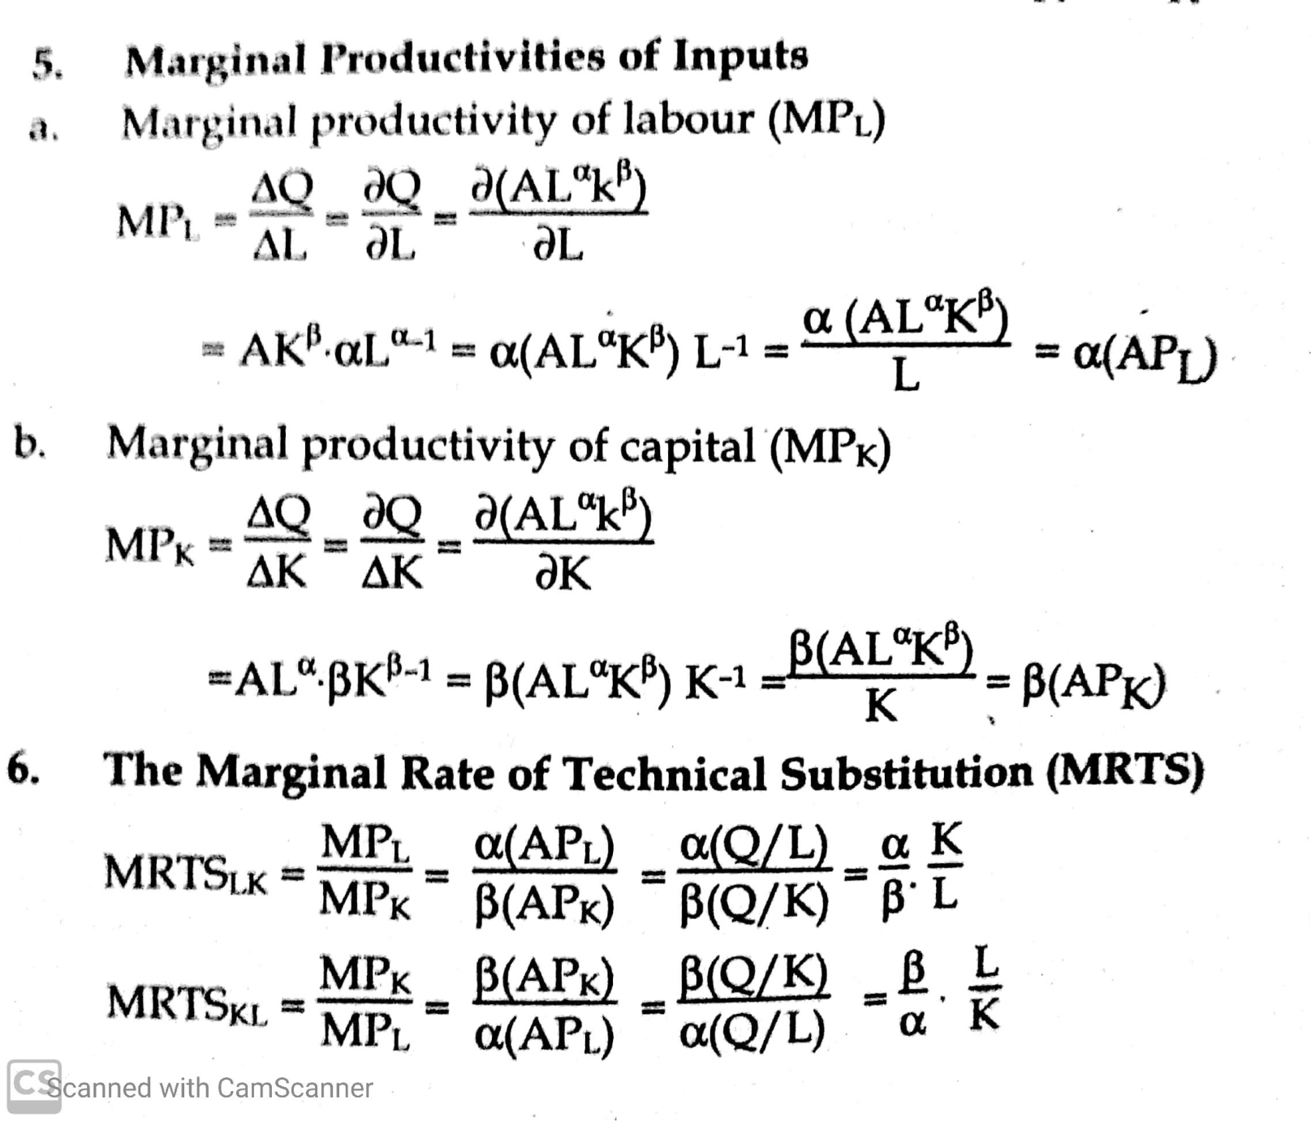

Slide 10
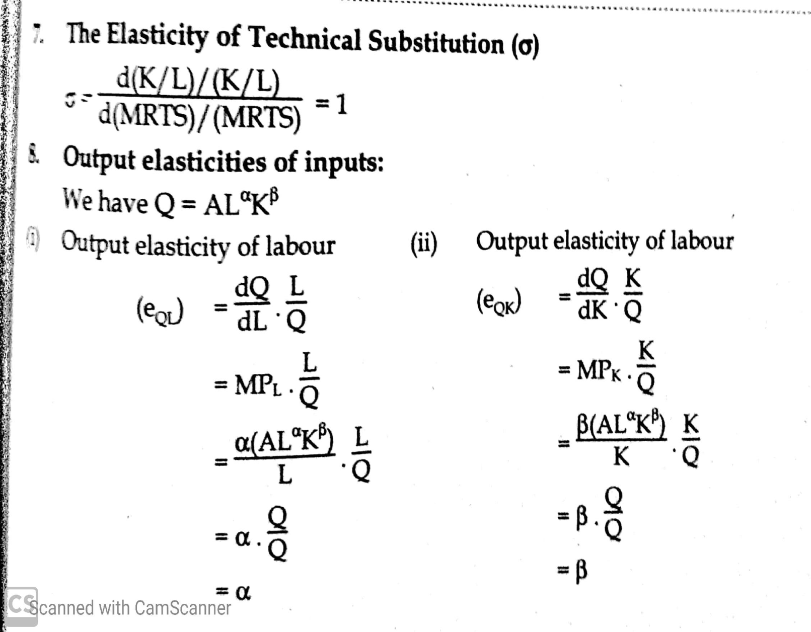

Slide 11
Questions for discussions
Differentiate production and production function.
What do you mean by Cobb-Doulash production function? Explain its properties.
Given the production function Q= 20K^{.8}L^{.4} then answer the following
what is the factor intensity and returns to scale?
Calculate average and marginal productivities of labour and capital.
Find the Marginal Rate of Technical substitution (MRTS_{LK}) and (MRTS _{KL}).
Calculate output elasticity of inputs.

Slide 12
Concept of Total, Average and Marginal product
Total product (TP): It refers to the total volume of goods and services produced by the firm by use of factor inputs and technologies. In another words it is the total amount of a commodity produced by the combination of all inputs in a given period of time. TP =AP *N or TP =∑MP TP=MP1+MP2+….+MP3
Where TP= total product, AP = Average product
MP=marginal product and N =total number of inputs
TP initially increase at increasing rate, and then it increases at decreasing rate and reaches at maximum point when the value of MP is zero. Finally it starts to fall beyond the maximum point to continuous increase in labour unit.

Slide 13
Contd..
2. Average product (AP): it is the outcome of total product divided by total units of the input. In another words it refers to the per unit output (productivity) of input. AP=TP/N
Average product of labour AP_{L}= TP/L
Average product of capital AP_{K}=TP/K
In the beginning, increases, reaches at maximum point and finally starts to decrease.
3. Marginal product (MP): it is the addition made to the total product while one more unit of input is used. In another words it is the ratio of change in total product with the change in units of inputs
MP=∆TP/ ∆N
Firstly, MP increase faster than AP, reaches at maximum point and starts to fall faster than average product, and then become zero and negative.

Slide 14
Law of variable proportion/law of diminishing marginal producvity/returns
It was developed by famous economist Alfred Marshall, Benham, Samuelson, and Robbins.
It states and analyses the phenomenon of short-run production.
It examines the production relation with one factor (i.e. labor) as a variable, keeping other factors fixed.
When the quantity of one factor is changed keeping the quantities of other factors constant the proportion between the variable factor and fixed factor is changed therefore, it is known as law of variable proportion.

Slide 15
Contd…
According to this law, as the quantity of a variable factor is increased by equal amount keeping the quantities other factors constant, initially total product (TP) increases at an increasing rate, but after a point increases at a diminishing rate, becomes maximum and start to decline. AP increases to a certain point after that it continuously decreases. MP also increases as other product but it increases faster then AP and start to decrease, when TP reaches maximum it becomes zero and it may be negative as well.

Slide 16
Assumptions of law of variable proportion.
States of technology is given and constant
Only one factor is variable and others are constant
This law is based on short-run production function.
The law of variable proportion schedule
Land (in acre) | Units of labor | TP/Q | AP=Q/L | MP | Stages
5 | 0 | 0 | - | - | Stage 1st Stage of increasing returns
5 | 1 | 10 | 10 | 10
5 | 2 | 30 | 15 | 20
5 | 3 | 60 | 20 | 30
5 | 4 | 80 | 20 | 20
5 | 5 | 90 | 18 | 10 | Stage 2nd Stage of decreasing returns
5 | 6 | 90 | 15 | 0
5 | 7 | 80 | 11.4 | -10 | stage 3rd stage of negative returns

Slide 18
Stages of the Law: the law of variable proportion can be divided into three stages.
Stage I (increasing Returns):
Total product (TP): increases at an increasing rate to a certain point and then rate of increasing switches from increasing to diminishing.
Average product (AP): increases throughout this stage and reaches to maximum at point.
Marginal product (MP): initially increases reaches maximum point and start to decline. When AP and MP touch and become equal this stage ends in our above figure at 4 units of labour this stage ends.
Causes of increasing returns:
Increase in efficiency of fixed factors
Increase in the efficiency or productivity of variable factor

Slide 19
Stage II (Decreasing returns):
TP continues to increase at a diminishing rate until it reaches it’s maximum point where second stage ends
In this stage both AP and MP are diminishes but are positive at the end of this stage MP is zero.
Causes of decreasing returns in second stage:
Scarcity of fixed factor
Indivisibility of fixed factor
Imperfect substitutability of the factors

Slide 20
Stage III (Negative Returns):
TP start to decrease
AP continuously decreases but never be zero and negative
MP decrease continuously so it becomes negative
Causes of Negative Returns in the third stage:
Variable factors are too much as compare to the fixed factors of production (too much cooks spoil the broth)
Indivisibility and scarcity of fixed factors

Slide 21
Stage of operation:
A rational producer never choose to produce in stage III where the marginal product of variable factors is negative even if variable factor is free.
A rational producer also does not choose to produce in stage I because the MP and AP of the variable product is increasing there is the possibility of more benefit when goods and services are produced more and more
Thus it is clear that a rational producer will produce in stage II where TP is increasing and both MP and AP of variable factors are diminishing so this law is also called law of diminishing returns. At which particular point in this stage, the producer will decide to produce depends upon the price of product and prices of factors.

Slide 22
Optimal Employment of One Variable Input
It refers to the optimum amount of labor which produce maximum output at a minimum cost.
The level of variable input which gives the producer maximum benefit at minimum cost.
Level of variable input in which producer be in equilibrium.
The conditions for producer’s equilibrium (or Optimum Employment of one variable input)
VMP_{L}=MC_{L} D_{L} = S_{L}
VMP_{L}= Value of marginal productivity of labor
MC_{L} = Marginal cost of labor

Slide 23
Cont…
Assumptions
Only one commodity is produced by employing only one variable input, i.e. labor.
The theory assumes that the goal of the firm is profit maximization.
Production technology remains constant.
An economy is operating at full employment in the long run
There is operation of law of diminishing marginal returns in the productivity of labor.
There is existence of perfect competition in both product and factor markets.

Slide 24
(VMP_{L}) Value of marginal productivity of labor or demand for labor (D_{L}): demand for labor is the product of marginal productivity of labor and per-unit price of output
So VMP_{L} or D_{L}= Px*MP_{L} OR MRP_{L} = MP_{L}*MR
The marginal productivity of labor is the ratio of the change in total productivity of labor with the change in units of labor (i.e. MP_{L}=△TP/△L)
Due to the operation of law of diminishing returns in the productivity of labor MP_{L} decline continuously with an increase in units of labor.
Due to the perfectly competitive market price of the product remains constant at any level of output of the firm.
Hence VMP_{L} or D_{L} declines continuously with an increase in units of labor VMP_{L} curve slopes downwards to the right

Slide 25
Marginal cost of labor (MC_{L}) supply of labour =W
MC_{L} or marginal wage is the wages paid to the each additional units of labor.
Due to the perfectly competitive market firm can not influence on wage rate and then it has to hire any unit of labor at given wage rate.
Hence MC_{L} curve slopes as a straight line to X-axis.
The firm being a profit maximiser, will hire a factor where MC_{L} equals to value of marginal productivity of labor.
It never pays a wage which is greater (or less) than the marginal productivity of labor.
Therefore, the firm will go on hiring more and more labor so long as the addition made to the total productivity of additional labor is greater than the wage rate.

Slide 26
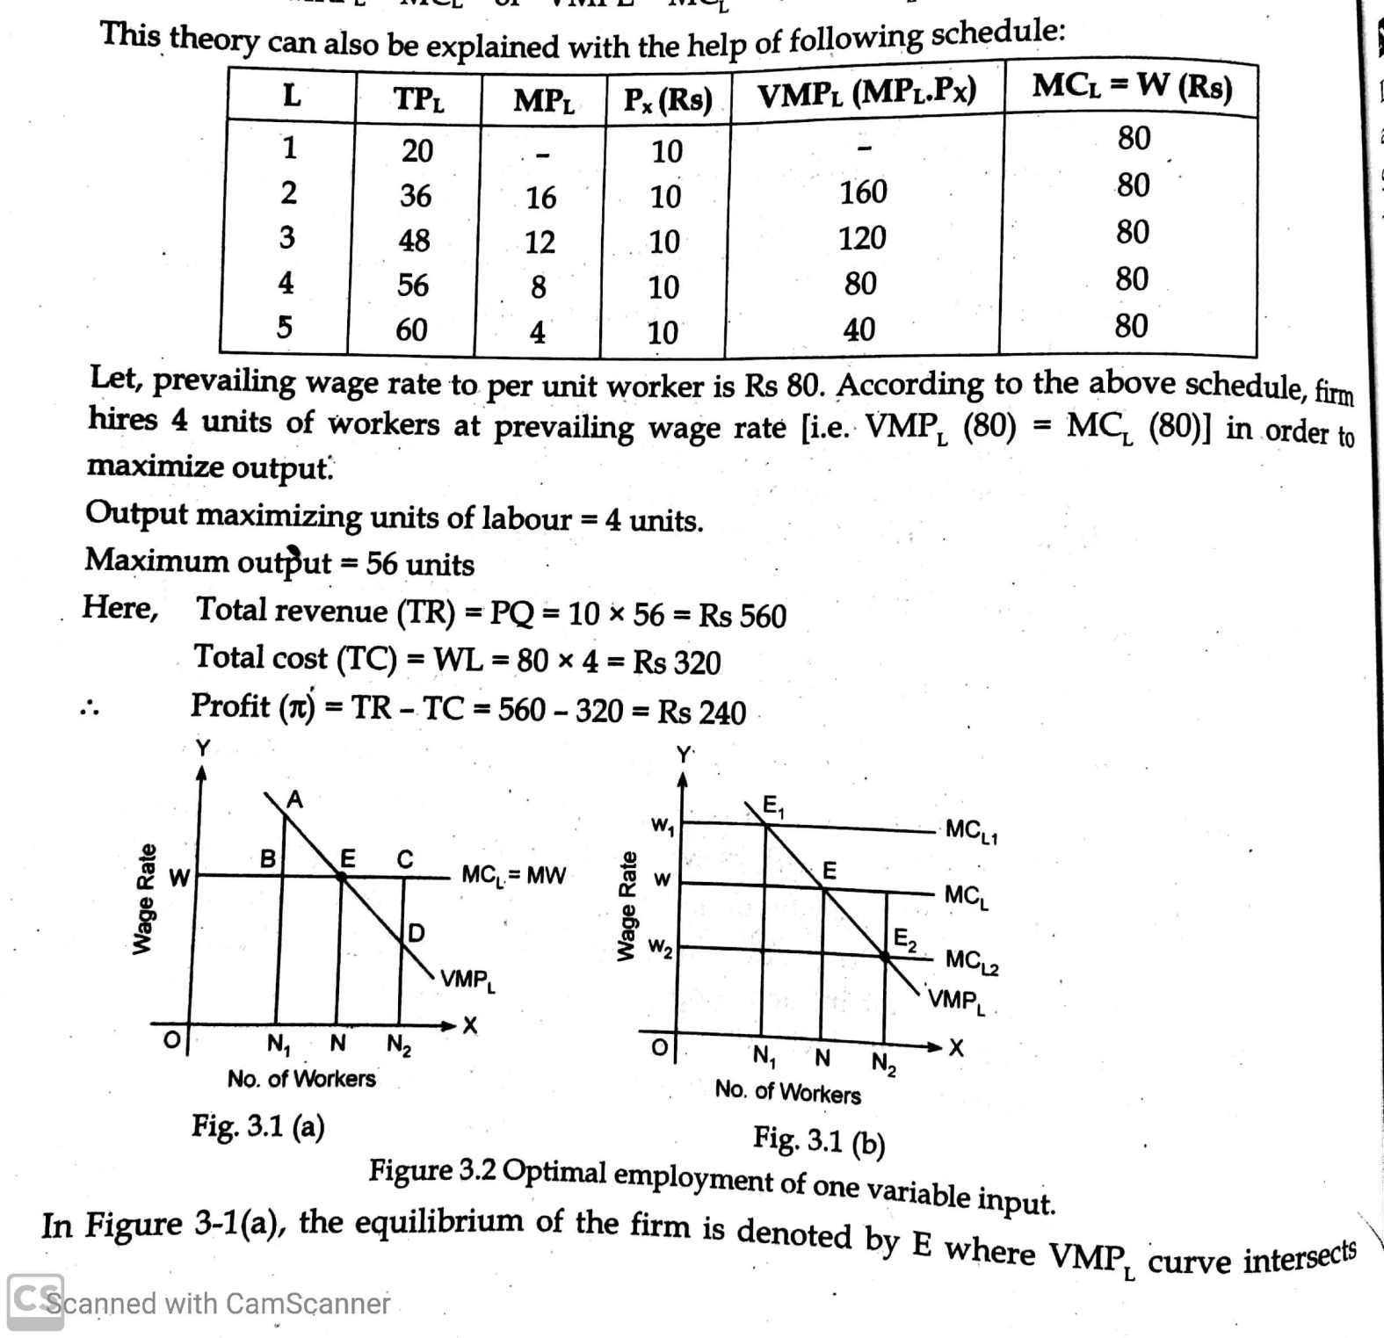

Slide 27
Questions
1. Let production function Q= 196L-6L² price(P)=Rs40, wage rate (w)= Rs 80, fixed cost (c)= Rs10,000
Discuss the law of variable proportion.
Determine profit maximizing unit of labor, maximum output. What is the profit?
What will be maximum output and profit when wage rate increase to Rs 120?
2. Let production function Q= 98L-3L² price(P)=Rs200, wage rate (w)= Rs400, fixed cost (c)= Rs100,000
Compute the profit maximizing unit of labor, maximum output. What is the profit?
What will be maximum output and profit when wage rate increase to Rs 520?

Slide 28
Group II
Situation Analysis 1
Kathmandu designers Pvt. Ltd. Is a firm among hundreds of firms providing services of computer typing in both Nepali and English language. The firm starts its service with three computers and one worker in one room. The worker type documents deals with customers, keeps account and accomplishes other office work. The worker types 100 pages per day. When demand increases, the firm hires one more worker and assigns only the typing job for one person and all the other jobs to next person. As a result, the worker types 240 pages per day. Similarly, the firm hires third worker to meet more demand and assigns English typing for one person, Nepali types for one person and all other jobs to another person. As a result they type 390 pages per day. The firm hires fourth worker and assigns job: one person for typing for Nepali, two persons for typing English and one person for all other jobs. The firm produces 520 pages in a day. When the firm hires five workers and assigns job as: two workers for typing Nepali, two workers for typing English one worker for all other jobs. The firm produces 610 pages in a day. When firm hires sixth, seventh and eighth worker its output is 660, 660 pages and 640 pages respectively.

Slide 29
Contd..
The sixth worker assigned for customer dealing separately. Seventh worker is assigned as accountant separately. When the firm employees 8 workers the job is divided as: two for Nepali typing, two for English typing, one for customer dealing, one for account keeping and two for office support.
In competitive factor market with homogeneous labour, Kathmandu Designers Pvt. Ltd can hire at rate Rs. 1000 per day. The service charge of the product is Rs. 20 per page.
Find the optimum units of labour for Kathmandu Designers Pvt Ltd.
Find the level of profit for one month if the total cost (other than labour charge) of one month of Kathmandu Designers Pvt Ltd is Rs. 200000.

Slide 30
Optimal employment of two variable inputs
Isoquant: an isoquant (or equal product curve or product indifference curve) is a locus of representing different combination of two inputs (labor and capital) which yield the same level of output to the producer.
It slopes downwards to the right as rectangular hyperbola.
It is due to the operation of law of diminishing marginal rate of technical substitution.
It is also shows producers preference
Q=f(L,K)

Slide 31
Cont…
Assumptions:
Only two inputs, labor and capital are assumed to be variable
There is operation of law of diminishing marginal rate of technical substitution between two inputs
Production function is continuous, implying that labor and capital are perfectly divisible and can be substituted in any small quantity.
Producer must be rational.
Transitivity

Slide 32
isoquant
combinations | Capital | labor | MRTS | output
A | 1 | 15 | - | 200
B | 2 | 11 | 1:4 | 200
C | 3 | 8 | 1:3 | 200
D | 4 | 6 | 1:2 | 200
E | 5 | 5 | 1:1 | 200

Slide 33
Law of diminishing marginal rate of technical substitution (MRTS):
MRTS is a rate at which units of two inputs are substituted to each other to maintaining same level of output to the producer.
It is the ratio of the change in units of one input (say labor) with the change in unit of another input (say, capital)
Q=f(L,K) ….(i) IQ production function
-△L MP_{L} …(ii) when producer sacrifices some units of labor total output will change
+△K MP_{K} ….(iii) when he changes some unit of capital, total output will change
-△L MP_{L} = +△K MP_{K}
-△L/△K =MP_{K}/MP_{L} ..... (iv)

Slide 34
Properties or characteristics of Iso-quant
It has negative slopes. Or Isoquant always slopes downwards from left to the right.
It is convex to the origin.
Isoquants never intersect to each other.
Higher Isoquant represents higher output and lower Isoquant lower quantity.
Labor
Labor
a
b
IQ2
IQ1
IQ
c
0
Capital
0
Capital

Slide 35
Linear isoquants
Capital | Labour | quantity | MRTS
0 | 25 | 10 | -
1 | 20 | 10 | 1:5
2 | 15 | 10 | 1:5
3 | 10 | 10 | 1:5
4 | 5 | 10 | 1:5
5 | 0 | 10 | 1:5

Slide 36
L-shaped isoqunat
Capital | Labour | Quantity
4 | 1 | 10
3 | 1 | 10
2 | 1 | 10
1 | 1 | 10
1 | 2 | 10
1 | 3 | 10
1 | 4 | 10

Slide 37
Iso-cost line:
It is the locus of various combinations of inputs along which a producer makes same level of expenditure.
It represents the budget constraint of the producer
It shows the various combinations of two factor inputs that can be hired by the producer with his/her given total investment expenditure.
C = wL + rK ……. i) Iso-cost line equation
where C = total cost/ investment expenditure
w= wage rate, L = unit of labor, r= rate of interest, K = unit of capital

Slide 38
Cont……
Let C = Rs100. w= Rs10, and r =Rs20 then Iso-cost line is drawn as 100=10L+20K
C=wL+rK
when L = 0, K= C/r = 100/20 = 5 a point of Iso-cost line
When K=0, L=C/w = 100/10= 10 another point of Iso-cost, then
Slope of iso-cost is
dK/dL= - w/r
C=wL+rK
labor
10
0
5
capital

Slide 39
Cont…..
Causes of shift in Iso-cost line
Change in total cost/ total investment expenditure
When total cost increase it shift rightward
When total cost decrease it shift leftward
b) Change in input prices
If price of the inputs decreased it shift rightwards
If price of the inputs increased it shift leftwards

Slide 40
Least cost combination of two inputs or optimal combination of two inputs or producer’s equilibrium
It represents that units of labor and capital which yield maximum output at minimum cost to the producer.
It is also called the optimal combination of factor inputs because there is no any other combinations of these two factor inputs which gives maximum output at minimum cost to the producer besides this combination.
At this combination of factor inputs producer is able to achieve their goal of to producer maximum output at minimum cost so this is also called the producer’s equilibrium point.
There are two approaches to explains the producer’s equilibrium. a. maximization of output at given total cost outlay. b. minimization of cost at given production quota.

Slide 41
a. Maximisation of output at given total cost outlay
Assumptions
Producer must have iso-quant map and iso-cost line
Producer must be rational.
Total cost outlay and prices of two inputs remain fixed
Producer has to maximise output by investing fixed total outlay on two inputs (labor and capital) at minimum cost.
Conditions:
Necessary(1st order) condition: iso-cost line is tangent to iso-quant(or the slope of iso-quant equals to the slope of iso-cost line, (i.e. MRTS_{KL} =MP_{K}/MP_{L} )= r/w
Sufficient (2nd order) condition: iso-quant must be convex to the origin at tangent point

Slide 42
Producer’s equilibrium
labor
A
f
e
L
IQ3
g
IQ2
IQ1
0
K
B
capital

Slide 43
Expansion path:
labor
g
A
P
e3
Expansion path
C
e2
L
e1
IQ3
IQ2
IQ1
0
K
D
B
f
capital

Slide 44
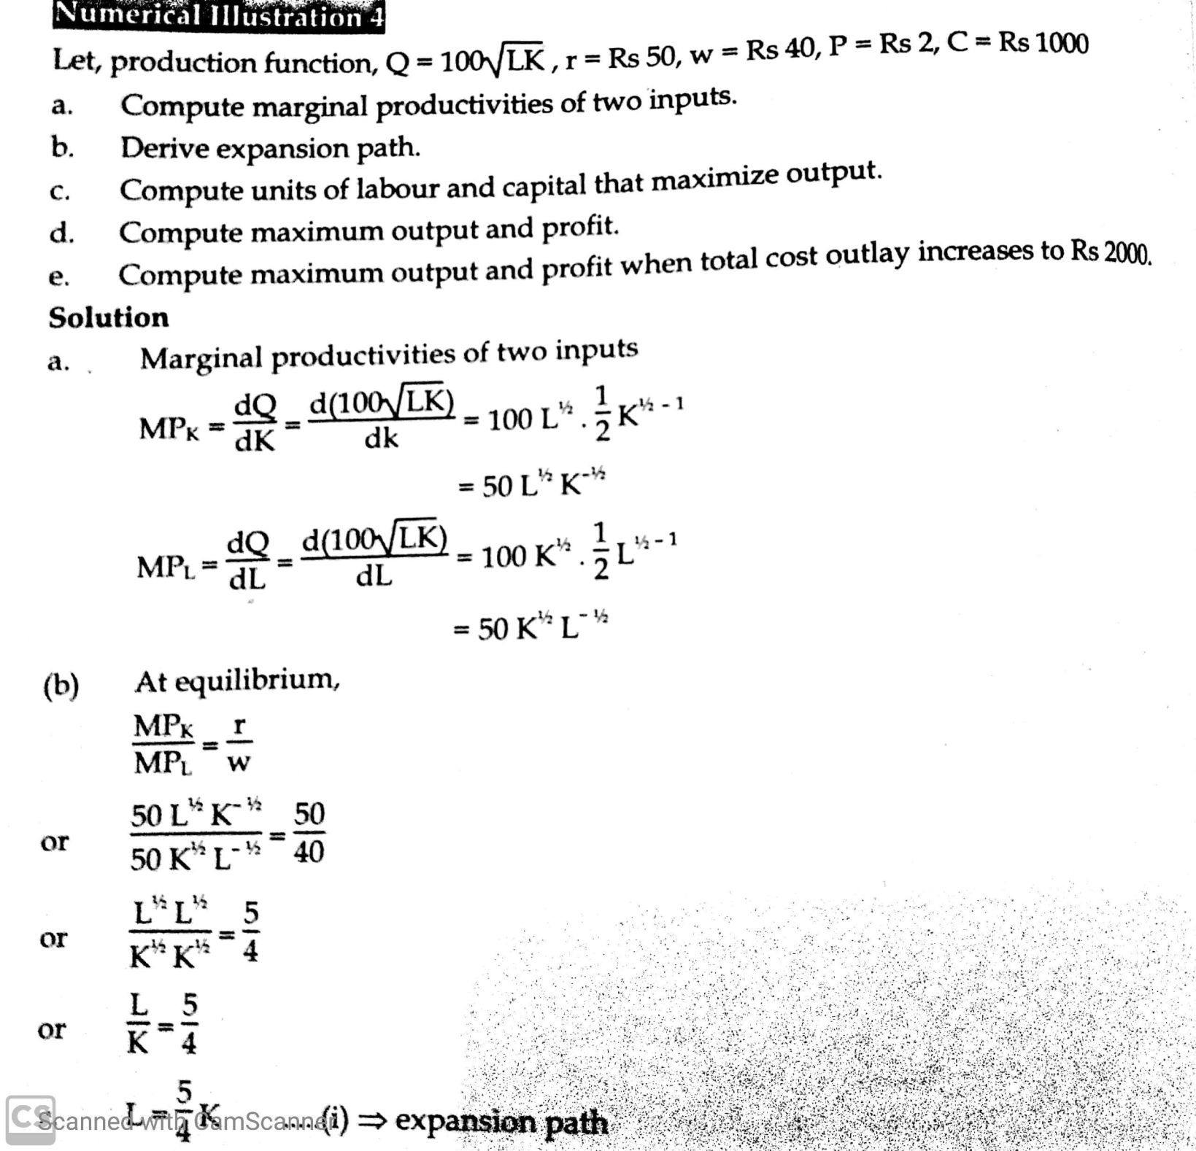

Slide 45
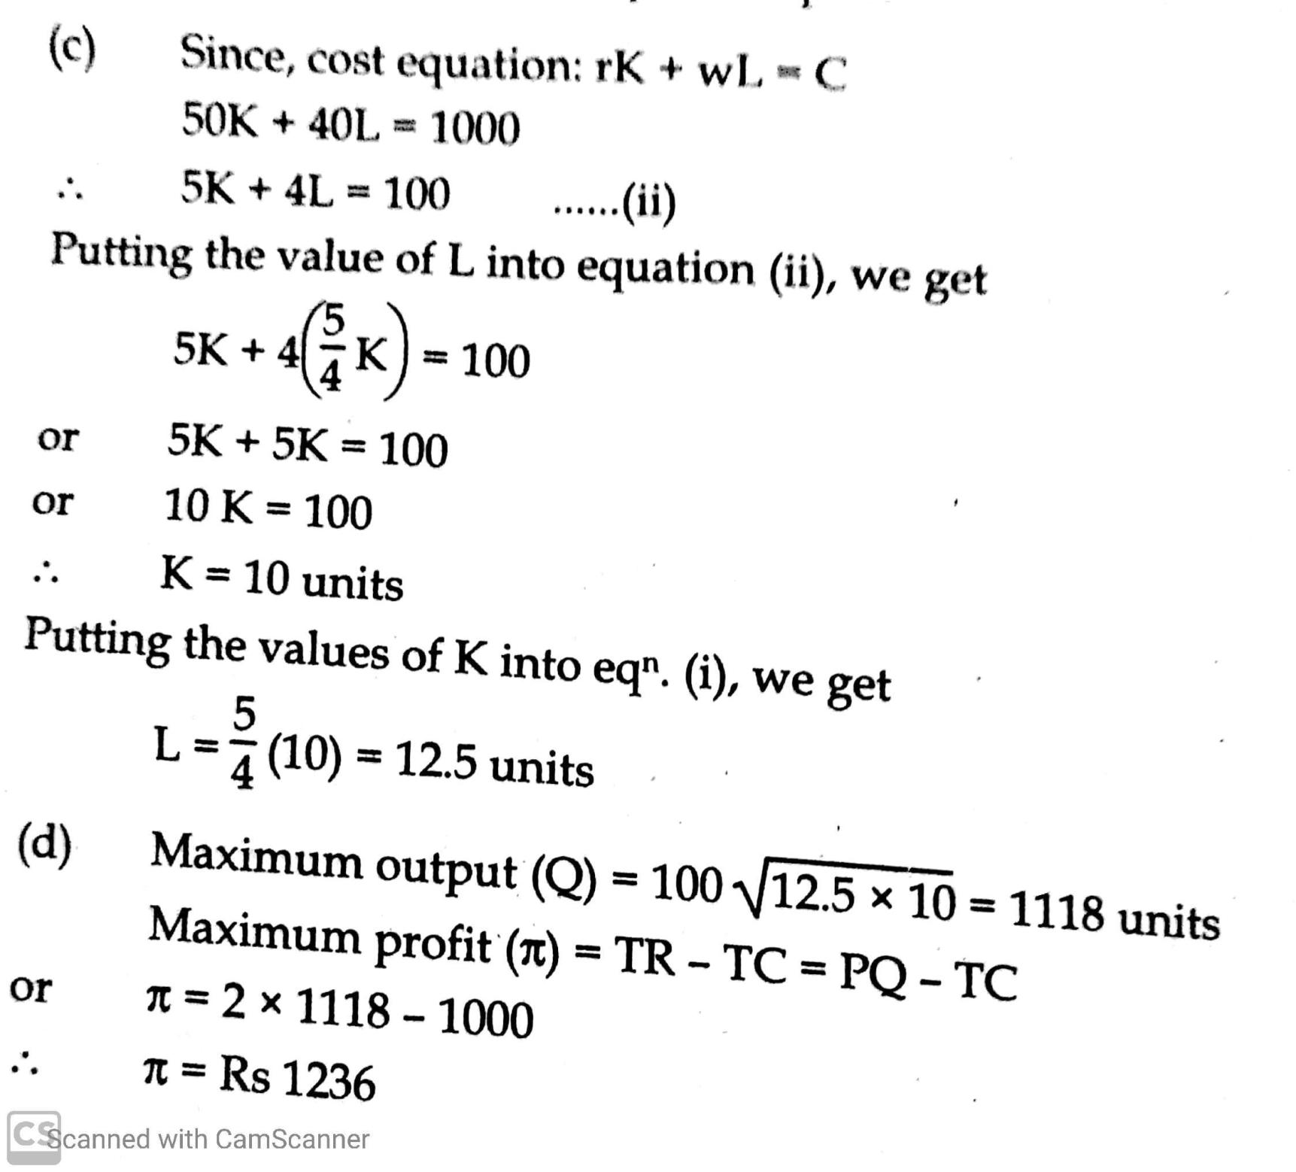

Slide 46
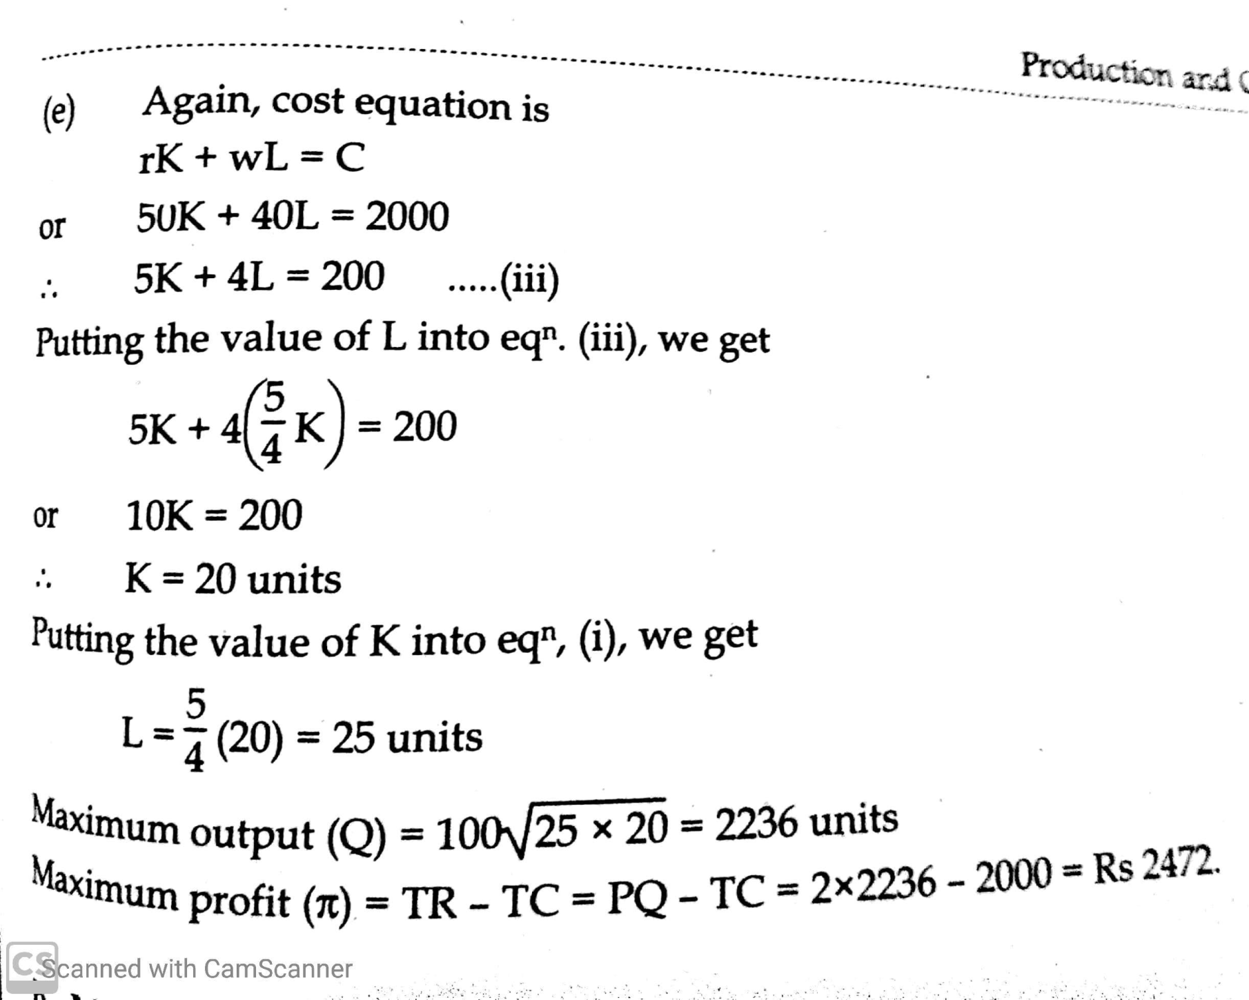

Slide 47
B. Minimization of cost at given production quota
If the entrepreneur has already decided about the level of output to be produced.
Assumptions
Producer must have iso-quant and family of iso-cost line.
Producer must be rational.
Prices of two inputs remain fixed.
Producer has different level of investment capacity or total cost outlay.
Producer has to produce given level of output at minimum cost.
Conditions:
Necessary(1st order) condition: iso-cost line is tangent to iso-quant(or the slope of iso-quant equals to the slope of iso-cost line, (i.e. MRTS_{KL} =MP_{K}/MP_{L} )= r/w
Sufficient (2nd order) condition: iso-quant must be convex to the origin at tangent point

Slide 48
Least cost combination of two factor inputs
labor
g
r
A
C
e
L
s
IQ2
0
K
D
B
f
capital

Slide 49
Law of returns to scale
It is associated with long run production function
It examines the relationship between output and the scale of inputs in the long run when all the inputs are increased in the same proportion.
Firm increases its scale of production by using more space, more machines and labourers (as inputs)
“Law of returns to scale refers to the relationship between to the changes in output and proportionate change in all factors of production” Roger Miller

Slide 50
Assumptions
All factors are variable enterprise is fixed.
No change in state of technology
There is perfect competition
The product is measured in quantities.
Stages of law of returns to scale
Increasing returns to scale (IRS)
Constant returns to scale (CRS)
Decreasing returns to scale (DRS)

Slide 51
Increasing returns to scale (IRS): if the output of a firm increases more than in proportion to an equal percentage increase in all inputs, the production is said IRS. e.g. if amount of inputs are increased by 10% then output increases by more than 10% (say 15%)
Constant returns to scale (CRS): if output increases at the same proportion as that of inputs, then it is known as CRS. e.g. if factor inputs increase by 10% then output also increase by same 10%
Decreasing returns to scale (DRS): if the output increases at less proportion than the increase in inputs then the production scale is said to be DRS. e.g. if inputs increases by 10% then output increases by less than 10%

Slide 52
Units of labour | Units of capital | Total units of inputs | Total units of output | result
2L | 2K | 2L+2K | 100 (IQ1) | Increasing returns to scale
4L | 4K | 4L+4K | 300 (IQ2)
8L | 8K | 8L+8K | 700(IQ3)
4L | 4K | 4L+4K | 200(IQ2) | Constant returns to scale
8L | 8K | 8L+8K | 400 (IQ3)
4L | 4K | 4L+4K | 180 (IQ2) | Decreasing returns to scale
8L | 8K | 8L+8K | 300(IQ3)

Slide 53
Returns to scale
Increasing returns to scale
Causes of increasing returns to scale: Economies of scale
Technical and managerial indivisibles/economies
Higher degree of specialization
Dimensional relations
Transportation economies
Advertising economies
OA>AB>BC
Labour
C
B
IQ3=300
A
IQ2=200
IQ1=100
O
Capital

Slide 54
Returns to scale
Constant returns to scale
Causes of constant returns to scale: There is balance between internal and external economies of scale and diseconomies of scale
OA=AB=AC
Labour
C
B
IQ3=300
A
IQ2=200
IQ1=100
O
Captial

Slide 55
Returns to scale
Decreasing returns to scale
Causes of decreasing returns to scale: Diseconomies of scale
Managerial diseconomies
Limitedness or exhaustibility of the natural resources
Labour diseconomies
Pecuniary diseconomies (discount and concession)
OA<AB<BC
C
Labour
IQ3=300
B
A
IQ2=200
IQ1=100
O
Capital

